Slide 1
Discrete Mathematics
Dr. Han Huang
South China University of Technology
1

Slide 2
Chapter 5. Trees
Minimum Spanning Trees
Section 5.5
2

Slide 3
Example of Computer Network
$2000
D
E
$1000
$1200
$1300
$1600
$900
$800
A
$700
$1400
B
$2200
C
We can solve the problem by finding a spanning tree so that the sum of weights of the edges of the tree is minimized. Such a spanning tree is called a minimum spanning tree.

Slide 4
Minimum Spanning Trees
Definition 1 : A minimum spanning tree in a connected weighted graph is a spanning tree that has the smallest possible sum of weights of its edges.
There are two algorithms for building the minimum spanning trees.
1. Prim’s Algorithm
2. Kruskal’s Algorithm

Slide 5
Algorithm 1 : Prim’s Algorithm
Procedure Prim (G: weight connected undirected graph with n vertices )
T:= a minimum weight edge
for i:=1 to n-2
begin
e:=an edge of minimum weight incident to a vertex in T and not forming a simple circuit in T if added to T.
T:=T with e added
end {T is a minimum spanning tree of G}
O(e*log v)

Slide 6
Example 1
$2000
D
E
$1000
$1200
$1300
$1600
$900
$800
A
$700
$1400
B
$2200
C
1 {C, D} $700 2 {C, E} $800
3 {D, A} $1200 4 {A, B} $900
Total : $3600

Slide 7
Example 2
a
b
c
d
2
3
1
1 {b, f} 1
2 {a, b} 2
3 {f, j} 2
4 {a, e} 3
5 {i, j} 3
6 {f, g} 3
7 {c, g} 2
8 {c, d} 1
9 {g, h} 3
10 {h, l} 3
11 {k, l} 1
3
1
2
5
f
g
h
e
4
3
3
4
2
4
3
i
j
k
l
3
3
1
a
b
c
d
2
1
3
f
1
g
2
h
e
3
3
2
3
i
j
k
l
3
1

Slide 8
Algorithm 2 : Kruskal’s Algorithm
Procedure Kruskal (G: weight connected undirected graph with n vertices )
T:= empty graph
for i:=1 to n-2
begin
e:=an edge in G with smallest weight that does not form a simple circuit when added to T.
T:=T with e added
end {T is a minimum spanning tree of G}
O(e*log e)

Slide 9
Example 3
a
b
c
d
2
3
1
1 {c, d} 1
2 {k, l} 1
3 {b, f} 1
4 {c, g} 2
5 {a, b} 2
6 {f, j} 2
7 {l, h} 3
8 {f, g} 3
9 {g, h} 3
10 {i, j} 3
11 {a, e} 3
3
1
2
5
f
g
h
e
4
3
3
4
2
4
3
i
j
k
l
3
3
1
a
b
c
d
2
1
3
f
1
g
2
3
h
e
3
2
3
i
j
k
l
3
1

Slide 10
Applications
10

Slide 11
Applications
1.Apply Prim’s algorithm to find MST.
a
1
b
2
3
e
4
3
3
2
c
d
1

Slide 12
Applications
1.Apply Prim’s algorithm to find MST.
a
1
b
{a,b} 1
2
3
e
{a,e} 2
4
3
{e,d} 2
3
2
{d,c} 1
c
d
1

Slide 13
Applications
1.Apply Prim’s algorithm to find MST.
a
1
b
2
e
2
c
d
1

Slide 14
Applications
2.Apply Kruskal’s algorithm to find MST.
a
b
c
5
4
2
3
5
6
3
e
f
d
7
1
6
3
4
4
8
i
g
4
h
2

Slide 15
Applications
2.Apply Kruskal’s algorithm to find MST.
a
b
c
{e,f} 1
5
4
{h,i} 2
2
3
6
3
{a,d} 2
5
e
f
{f,c} 3
d
7
1
{e,h} 3
6
3
4
4
8
{b,d} 3
i
g
{b,c} 4
4
h
2
{g,h} 4

Slide 16
Applications
2.Apply Kruskal’s algorithm to find MST.
a
b
c
4
2
3
3
e
f
d
1
3
i
g
4
h
2

Slide 17
Applications
3.某地需要兴建6个厂房、拟修筑道路连接该6处。经勘测其道路铺设预算如图所示，试给出一个铺设方案，使得各厂房互相连通而且总预算最小。

Slide 18
Applications
3.某地需要兴建6个厂房、拟修筑道路连接该6处。经勘测其道路铺设预算如图所示，试给出一个铺设方案，使得各厂房互相连通而且总预算最小。

Slide 19
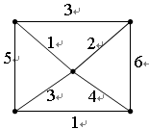
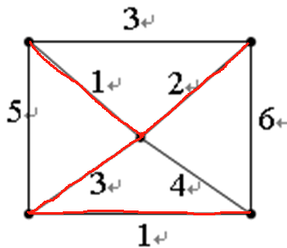
Exercises
1. The sum of the weights of the minimum spanning tree for the graph in the right hand side is _______
7
Notes:
好像涉及树

Slide 20
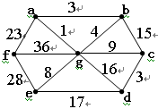
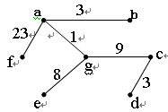
Exercises
2. A weight graph is given on the right side, representing seven cities a, b, c, d, e, f, g and the cost of their communication network. Please design a minimum cost of communication plan to make the cities communicate with each other.
The problem can be solved by constructing a minimum spanning tree on the right side.
The minimum cost is 1+3+9+3+8+23=47
Notes:
好像涉及树

Slide 21
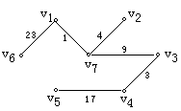
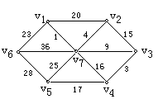
Exercises
3. Seven cities are constructing their network, and the cost of circuit is denoted by the weight of edge in the following graph. To make sure any two of the cities can communicate with each other (even there exist other cities between them), make a plan of minimum cost.
The circuits constructed are shown as follows. The minimum length is 57.
Notes:
好像涉及树

Slide 22
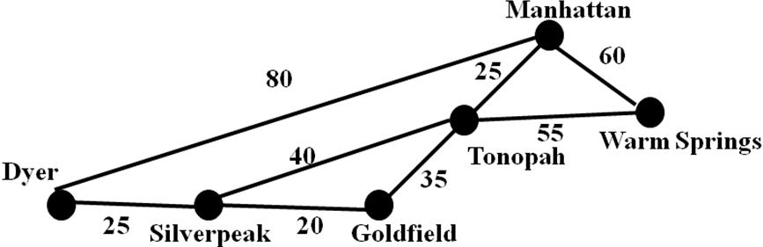
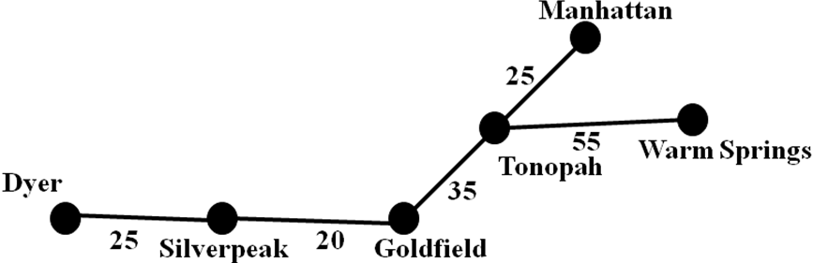
Exercises
4. The roads represented by this graph are all unpaved. The lengths of the roads between pairs of towns are represented by edge weights. Which roads should be paved so that there is path of paved roads between each pair of town so that a minimum road length is paved?
The roads should be paved are shown as follows. The minimum length is 160.
Notes:
好像涉及树

Slide 23
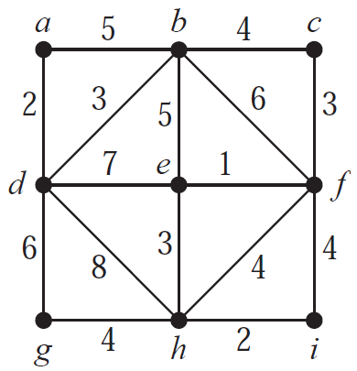
Exercises
5. Use Kruskal’s algorithm to find a minimum spanning tree for the weighted graph
{e, f }, {a, d}, {h, i}, {b, d}, {c, f }, {e, h}, {b, c}, {g, h}
Notes:
好像涉及树

Slide 24
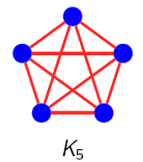
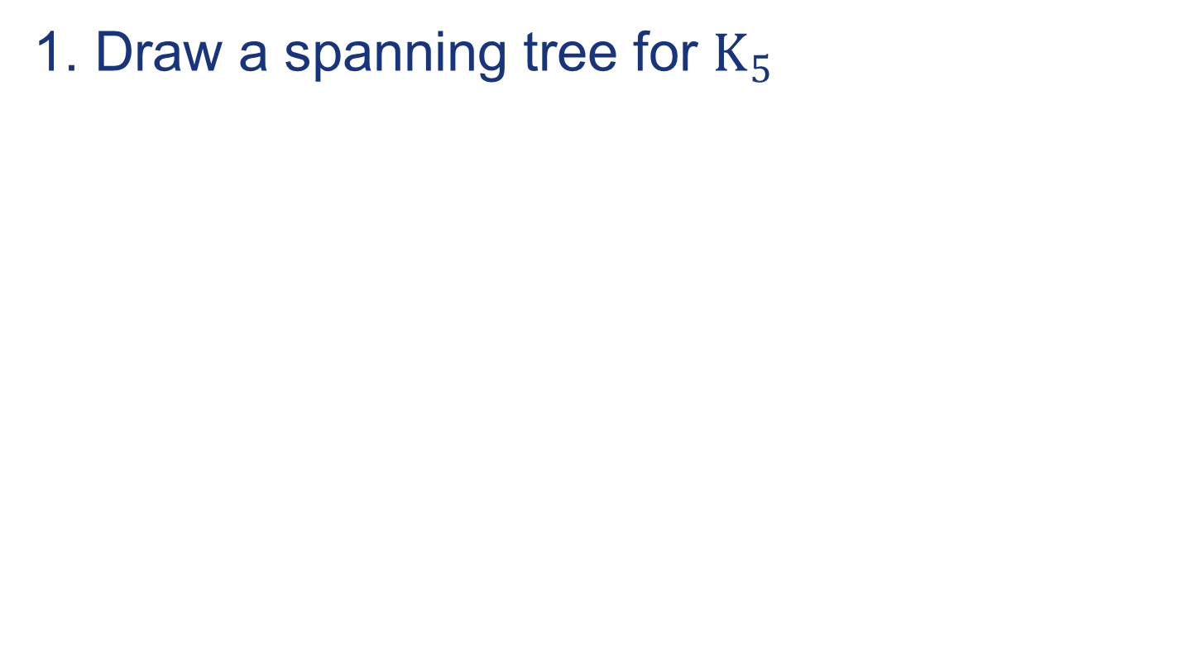

Exercises
6.
Notes:
好像涉及树

Slide 25
End of Section 5.5
Click to edit company slogan .
25

